Slide 1
Spock: It’s Testing, Jim, but Not as We Know It
Eric Galluzzo | Centric Consulting
eric.galluzzo@centricconsulting.com

Slide 2

Agenda
What is Spock?
Why do I care?
Anatomy of a Spock spec
Spock vs. JUnit
Let’s do some TDD!

Slide 3

What is Spock?
A specification-based testing framework
Specs are written in Groovy
Uses a heavily customized DSL to Make Testing FunTM!
Notes:
After “a specification-based testing framework”:
Now hang on, before you all file for the exits, give me a chance to tell you why Spock might actually be interesting and make your tests more fun to write and easier to read.
After the whole slide:
It’s always seemed rather odd to me that in, say, .NET, there are at least three commonly-used testing frameworks. In Ruby, there’s Test::Unit and RSpec -- oh, and AffirmIt, of course (if you haven’t seen it, take a look at affirmit.org). In JavaScript, there’s a new testing framework every week. But in Java, basically everyone uses JUnit and Mockito. OK, so there are a handful of weird people who use TestNG. But still, most people still even use JUnit 4 though JUnit 5 has been out for years. Why is this? Why are there no other options?
Do any of you use anything other than JUnit and Mockito?

Slide 4
Why do I Care?
Spock tests are very readable
Spock naturally expresses some things that are difficult in JUnit/Mockito
Spock includes its own mocking library that is integrated with its DSL
Spock includes soft assertions
The failure messages are really nice!

Slide 5
Don’t worry…
Spock is compatible with all your existing tools
You can still use all your favorite Hamcrest matchers
Spock is extensible, and includes both Spring and Guice integration
Notes:
Spock is implemented as a JUnit 5 engine.

Slide 6


Why shouldn’t I use it?

Slide 7

All the other people on your team
Notes:
You know, all those Luddites who couldn’t possibly learn something different than what they’ve always done. (This is sarcasm, by the way.)

Slide 8

It’s Groovy…
Notes:
So, some people might like Groovy, and some people might hate it. My honest reaction when I started writing Spock tests was, “Groovy is still a thing?” I thought everyone had moved to Kotlin, or just later versions of Java, at this point. I was surprised to find out that modern Groovy is compatible with Java 17. When we look at some code later, we’ll be using Java 17 and Groovy 3.0. But the good (or possibly bad) news is that the DSL you use to write Spock specs is actually kinda different even from straight Groovy.

Slide 9

Single Inheritance
Notes:
Like ye olde JUnit 3. In practice, this isn’t usually too much of a bother. And you shouldn’t really be using implementation inheritance anyway (which a lot of people do in test cases). But still…

Slide 10

Sometimes the magic leaks out
Notes:
Have you ever used Spring AOP, like the @Transactional annotation or something similar? And then you’ve called some public method in your class from some other public method in your class and it hasn’t applied the transaction? Then you have to read up on exactly how the aspects are implemented to figure out why it’s not working?
Well, the Spock DSL is nice, but sometimes a little wonky, and sometimes you have to understand what’s going on to some extent in order to use it effectively. In particular, I’m not sold on how mock return values are set up.

Slide 11
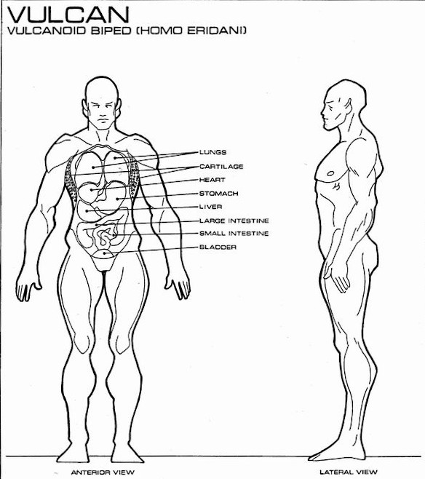
Anatomy of a Spock Spec

Slide 12
Basic Structure
import spock.lang.Specification class PersonSpec extends Specification { void "a Person's name should be what is given to it when it is created"() { given: var person = new Person("Eric") when: var name = person.name then: name == "Eric" } }
All specs must extend Specification
Set up the test
Natural language test method names are encouraged
Invoke the code under test
Assert what you expect to have happened
Any expression resulting in a Boolean in the “then” section is an assertion
Notes:
In Groovy, a method can be named with any arbitrary string.
Calling “person.name” actually calls “person.getName()” since this is Groovy. Also, I’m using “==“ because Groovy interprets it as an operator that ends up calling the equals() method.
You can have multiple sets of when/then blocks if you want, but you probably shouldn’t.

Slide 13
What to Expect when You’re Expecting
class PersonSpec extends Specification { void "a Person's name should be what is given to it, but using expect"() { given: var person = new Person("Eric") expect: person.name == "Eric" } }
“expect” combines when and then
Notes:
In general, “when”/”then” are useful for checking side effects. “expect” is better for testing purely functional methods.

Slide 14
Mocking
class PersonSpec extends Specification { void "determine results of COVID vaccination"() { given: var person = new Person("Eric") Syringe syringe = Mock() when: person.inject(syringe) then: 1 * syringe.empty(LEFT_ARM) >> COVID_VACCINE !person.magnetic person.microchipCount == 0 } }
Set up a mock of type Syringe
Expect one call to syringe.empty() with parameter LEFT_ARM
When this call is made, return COVID_VACCINE
Normal assertions from the test case (the side effects of calling person.inject(syringe)
Notes:
Spock can automatically determine what type it’s mocking by your type declaration.
Do you notice anything odd about how the return value is set up?
If you’re paying close attention, you may have noticed that we’re setting up the return value after the call that uses it has already happened. How does that work? Well, Spock looks at any expectations you have set up in the “then” section and moves the bits that set up the return values before the “when” section.

Slide 15
Data-driven Tests
void "determine results of injecting stuff"() { given: var person = new Person("Eric") Syringe syringe = Mock() when: person.inject(syringe) then: 1 * syringe.empty(LEFT_ARM) >> contents person.magnetic == magnetic person.microchipCount == microchipCount where: contents || magnetic | microchipCount COVID_VACCINE || false | 0 IRON_FILINGS || true | 0 RFID_TAG || false | 1 }
Variables defined in the “where” section
Table of values for these variables
Test method is executed once per line

Slide 16


Spock vs. JUnit

Slide 17
Parameterized Tests
void "determine results of injecting stuff"() { given: var person = new Person("Eric") Syringe syringe = Mock() when: person.inject(syringe) then: 1 * syringe.empty(LEFT_ARM) >> contents person.magnetic == magnetic person.microchipCount == microchipCount where: contents || magnetic | microchipCount COVID_VACCINE || false | 0 IRON_FILINGS || true | 0 RFID_TAG || false | 1 }
@ParameterizedTest @MethodSource("injectionTestArguments") public void determineResultsOfInjectingStuff( SyringeContents contents, boolean magnetic, int microchipCount) { var person = new Person("Eric"); var syringe = mock(Syringe.class); when(syringe.empty(LEFT_ARM)).thenReturn(contents); person.inject(syringe); verify(syringe).empty(LEFT_ARM); assertThat(person.isMagnetic(), is(magnetic)); assertThat(person.getMicrochipCount(), is(microchipCount)); } private static List<Arguments> injectionTestArguments() { return List.of( Arguments.of(COVID_VACCINE, false, 0), Arguments.of(IRON_FILINGS, true, 0), Arguments.of(RFID_TAG, false, 1) ); }
Nice table of values
Separate method to inject arguments
Notes:
By the way, I don’t actually expect you to read all the code on this slide. Just pay attention to the bits I’m going to highlight.
So, this injectionTestArguments method is separated from the test, which means it’s easier for them to get out of sync. It’s also not nearly as pretty, and you can’t easily see which argument corresponds to which test parameter.

Slide 18

Argument Testing
void "filling out vaccination card should only include vaccines"() { given: var person = new Person("Eric") Syringe vaccineSyringe = Mock() Syringe ironFilingsSyringe = Mock() VaccinationCard vaccinationCard = Mock() when: person.inject(vaccineSyringe) person.inject(ironFilingsSyringe) person.inject(vaccineSyringe) person.fillOut(vaccinationCard) then: 2 * vaccineSyringe.empty(_) >> COVID_VACCINE 1 * ironFilingsSyringe.empty(_) >> IRON_FILINGS 1 * vaccinationCard.record({ it.size() == 2 && it.stream().allMatch(c -> c == COVID_VACCINE) }) }
@Test public void fillingOutVaccinationCardShouldOnlyIncludeVaccines() { var person = new Person("Eric"); Syringe vaccineSyringe = mock(Syringe.class); Syringe ironFilingsSyringe = mock(Syringe.class); VaccinationCard vaccinationCard = mock(VaccinationCard.class); when(vaccineSyringe.empty(any())).thenReturn(COVID_VACCINE); when(ironFilingsSyringe.empty(any())).thenReturn(COVID_VACCINE); person.inject(vaccineSyringe); person.inject(ironFilingsSyringe); person.inject(vaccineSyringe); person.fillOut(vaccinationCard); verify(vaccineSyringe, times(2)).empty(any()); verify(ironFilingsSyringe, times(1)).empty(any()); @SuppressWarnings("unchecked") ArgumentCaptor<List<SyringeContents>> syringeContentsCaptor = ArgumentCaptor.forClass(List.class); verify(vaccinationCard, times(1)).record(syringeContentsCaptor.capture()); var vaccines = syringeContentsCaptor.getValue(); assertThat(vaccines.size(), is(2)); assertThat(vaccines.stream().allMatch(c -> c == COVID_VACCINE), is(true)); }
any() argument matcher
Underscore matches any argument
Use a lambda to match arguments

Slide 19
Let’s do some TDD!
Notes:
If you’re not familiar with it, TDD stands for Test-Driven Development, a really useful technique for writing well-tested production code. This isn’t a TDD presentation, but I’ll just tell you that the idea is that you write one failing test, then just enough code to make it pass, then refactor as necessary, and repeat until your code is done.

Slide 20
Standard Enterprise Service
StatusController
StatusService
WarpDrive
ShieldService

Slide 21
Status Endpoint
{ "warpDrive": { "warpFactor": 1.0, "lightSpeedMultiples": 1.0 }, "shieldPercentageRemaining": 23 }

Slide 22

Calculating Light Speed Multiples
The Original Series: $v\left(W\right)=W^{3}$
Voyager: $v\left(W\right)=W^{\frac{10}{3}}+{(10−W)}^{− \frac{11}{3}}$
Berry-Shields Equation: $v\left(W\right)=W^{\frac{10}{3}+Au(W−9){\left(−ln⁡(10−W)\right)}^{n} }$
$u\left(x\right)=\left\{\begin{aligned}0,x≤0 \\ e^{−\frac{1}{bx^{2}}}, x>0\end{aligned}\right.$
$A=0.03658749373$
$n=1.7952294708$
b is an arbitrary constant controlling the shape of the function at W = 9
Notes:
By the way, I’m not a Trekkie, I looked all this stuff up just for this presentation.
https://www.calormen.com/star_trek/warpcalc/

Slide 23

Live coding! What could possibly go wrong?

Slide 24

Questions?

Slide 25
Links
This presentation: https://github.com/egalluzzo/spock-presentation
Spock: https://spockframework.org/
TDD: https://www.agilealliance.org/glossary/tdd/
Notes:
FIXME: Add this presentation when it’s uploaded to Github

